Slide 1
PROJECT SEMINAR ON
ELECTRIC DRIVES
PRESENTED BY : SIDHARTHENEE NAYAK
GUIDED BY : Dr. SUBHAJYOTI MUKHERJEE

Slide 2
CONTENT
What are Electric Drives?
Parts of an Electric Drive System
Power Modulator
Electric Motor
Control Unit
Sensing Unit
Classification of Electric Drives (Group Drives, Individual Drives and Multi-motor Drives)
Control of Electric Drives(Current Limit Control, Torque Control and Speed Control)
Choice of Electric Drives
Application of Electric Drives
Conclusion
References

Slide 3
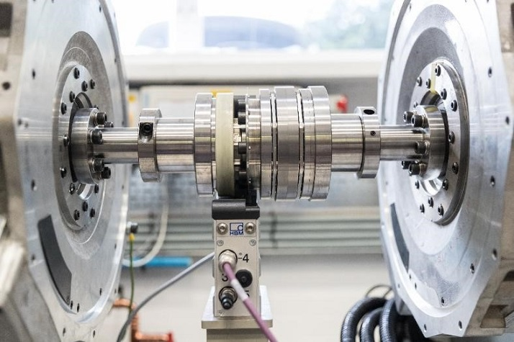
What are Electric Drives?
An Electric Drive can be defined as a system which is used to control the motion of an electrical machine.
This drive employs a prime mover as a main source of energy.
These prime movers supply the mechanical energy toward the drive for controlling motion.

Slide 4
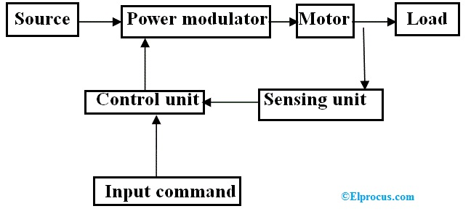
Parts of Electric Drives
The following make up an electric drive system:
Source
Power Modulator
Motor
Control Unit
Sensing Unit
Load

Slide 5
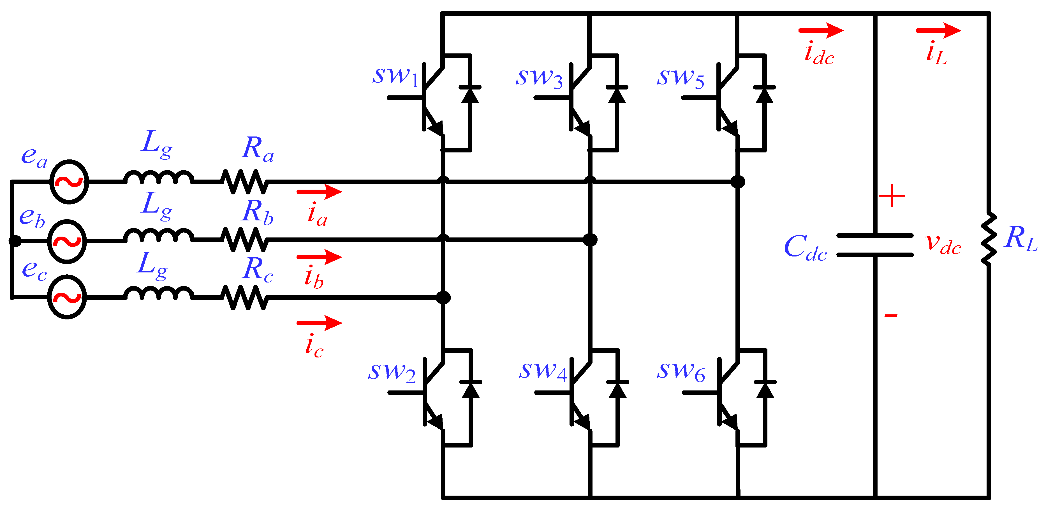
Power Modulator
This is used to control the supply from source to the motor so that the speed-torque characteristics required by the load is met. They can be made of thyristors, mosfets, IGBTs, etc.
It restricts the excessive current drawn from the source.
It converts the electrical energy from the source into a form suitable for the motor to operate.
It selects the mode of operation of the motor that is either motoring or braking.

Slide 6
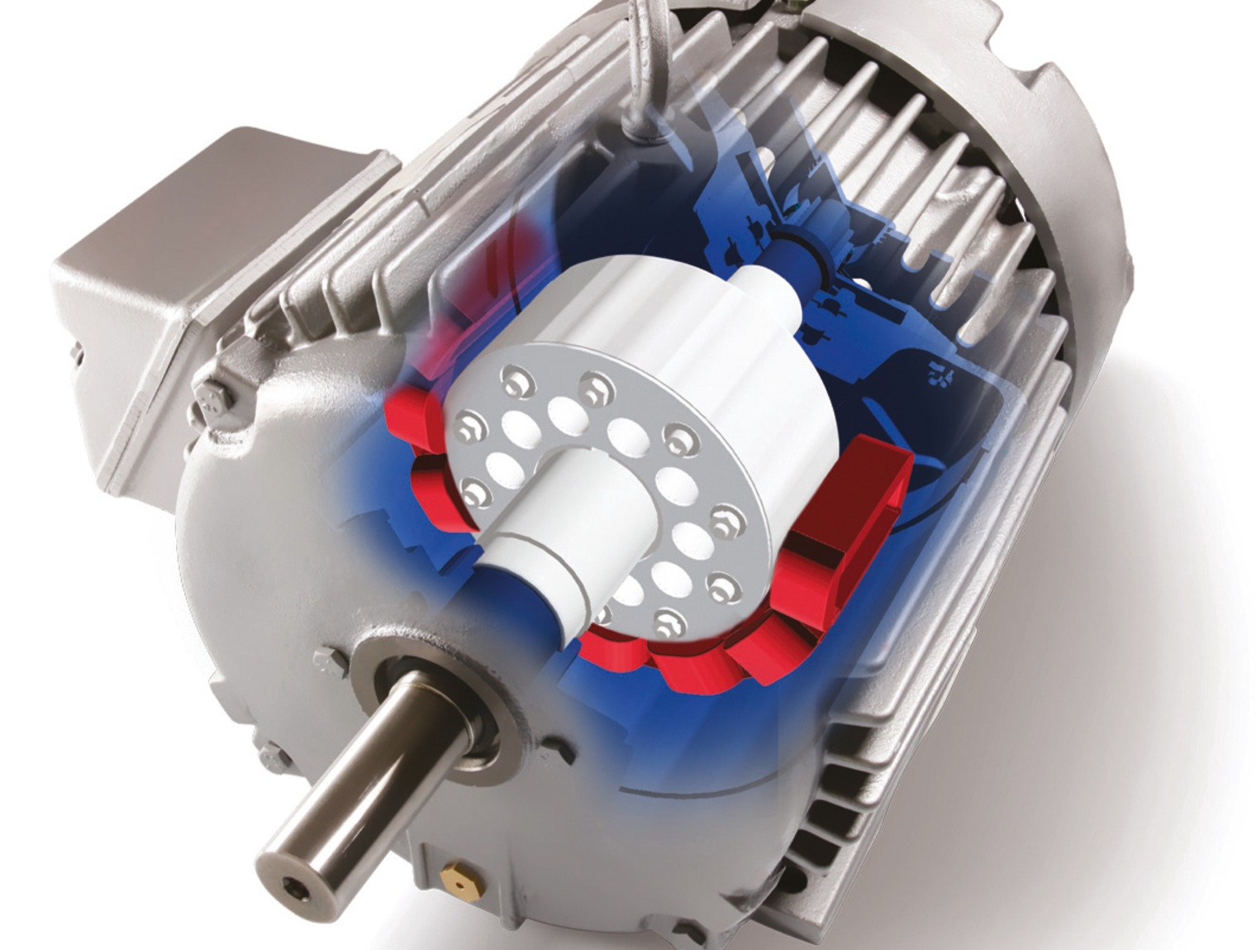
Electric Motor
Electrical motors used in the electric drives can be DC Motors or AC Motors like Induction Motor , Synchronous Motor.
The electric motor is chosen based on various features such as price, performance, requirements by the load, etc.
AC Motors are now being employed in variable speed drives as they have number of advantages over DC Motors.

Slide 7
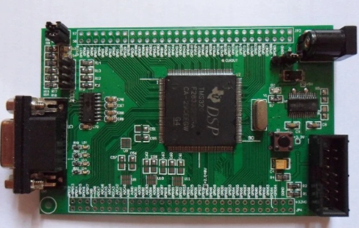
Control Unit
The control unit controls the power modulator.
It generates command for the protection of power modulator and motor.
When control of switching circuits is required then the function of control circuit will be to provide sequencing and interlocking.

Slide 8
Sensing Unit
The sensing unit in the electric drive is used to sense the particular drive factor such as speed, motor current or voltage.
They can be used for following sensing operation:
Speed sensing (Tachometer is used)
Torque sensing (Magnetoelastic torque sensor is used)
Position sensing (Position can be sensed through GPS, vibrometer, and rotary encoder.)
Current sensing and Voltage sensing (Hall Effect Sensors are used)
Temperature sensing (Temperature is sensed through thermistor)

Slide 9
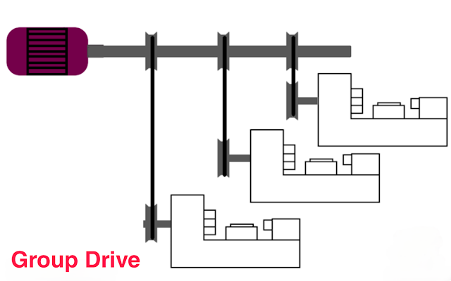
Classification of Electric Drives
Electric Drives are classified into three types: Group Drives, Individual drives, multi-motor drives.
1. Group Drives
When one prime mover or motor is used for a number of machine tools on common shaft then the drive is called as group drive.
Any fault in the driving motor renders all other driving component idle.
They are less flexible and noise level is high.

Slide 10
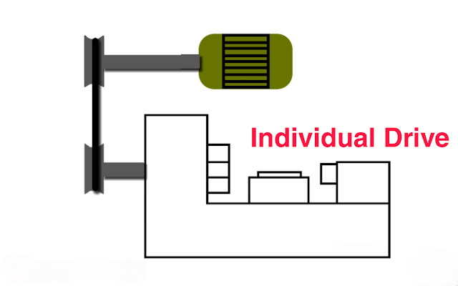
2. Individual Drive
If a single motor is used to drive or actuate a given mechanism and it does all the jobs connected with this load, the drive is called individual drive.
Each operator has complete control of its machines.
It has flexibility in layouts .
Efficiency and power factor is better.
But it has high initial cost and there is power loss during transmission.

Slide 11
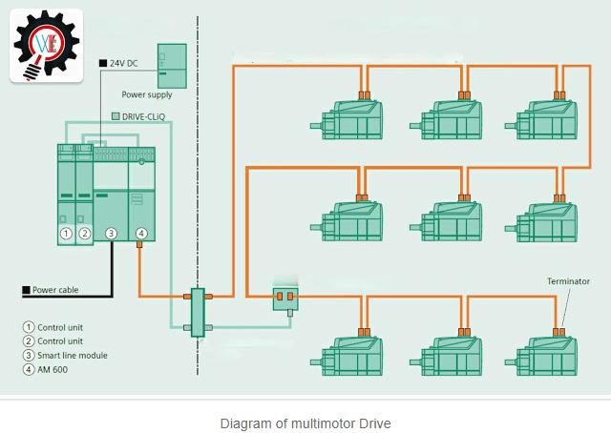
3. Multi-motor Drives
In multi motor drive, separate motors are used for operating different parts of same mechanism.
Since each machine is driven by a separated motor, it can be run and stopped as desired.
Machines not required can be shut down and also replaced with a minimum of dislocation.
It has high initial cost.

Slide 12
Control of Electric Drives
Control of electric drives is necessary since all the functions accomplished by the drives are mainly transient operations that is the change in terminal voltage, current, are huge which may damage the motor either temporarily or permanently.
In electric drives feedback loops or closed loop control satisfy the following requirements:
Protection
Enhancement of speed of response
Improvement in steady-state accuracy

Slide 13
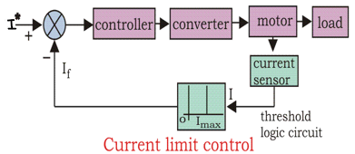
Control of Electric Drives (Cont...)
Different closed loop configurations used in control of electric drives are:
1. Current Limit Control
The feedback loop does not effect the normal operation of the drive but if the current exceeds the predetermined safe limit, the feedback loop activates and the current is brought down below the safe limit.

Slide 14
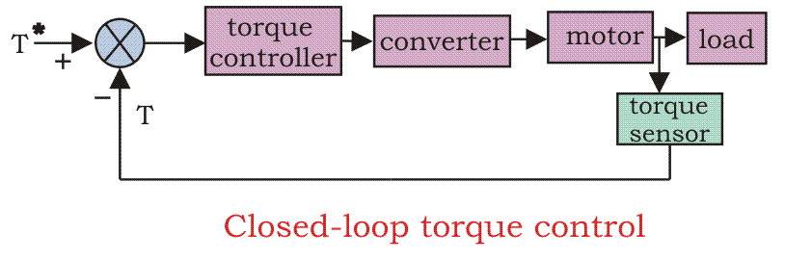
2. Closed Loop Torque Control
This type of torque controller is seen mainly in battery operated vehicles like cars, trains etc. The reference torque T* is set through the accelerator, and this T* follows by the loop controller and the motor. The speed of the drive is controlled by the driver via accelerator.

Slide 15
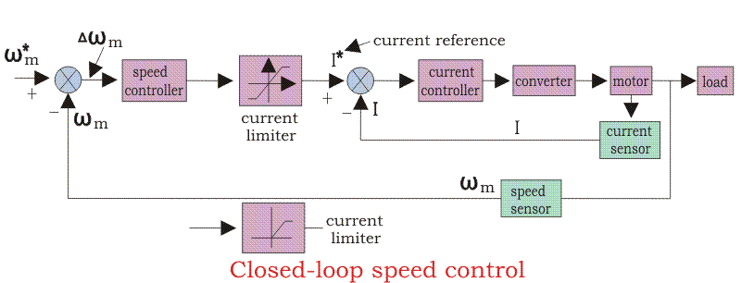
3. Closed Loop Speed Control
This is a cascade control system where speed is indirectly controlled by current sensors.
There are two control loops, which are inner loop and outer loop.
During speed controlling the function transfers from motoring to braking and from braking to motoring continuously for the smooth operation and running of the motor.

Slide 16
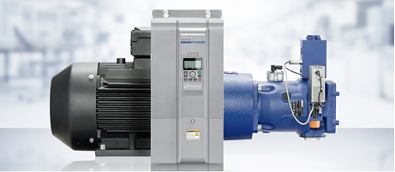
Choice of Electric Drives
Factors affecting the choice of electric drives are:
Steady state operation requirements
Transient operation requirements
Requirements related to source
Capital cost, maintenance, etc.
Environment and location
Reliability

Slide 17
Application of Electric Drives
The main application of this drive is electric traction. The different types of electric tractions mainly include electric trains, buses, trolleys, trams, and solar-powered vehicles inbuilt with battery.
Electrical drives are used in domestic and industrial applications which includes motors, transportation systems, pumps, etc .
These are used as main movers for petrol or diesel engines, turbines like gas otherwise steam, motors like hydraulic and electric.

Slide 18
CONCLUSION
Thus, this is all about the fundamentals of electric drives. From the above information, finally, we can conclude that a drive is one kind of electrical device used to control the energy which is sent to the electrical motor. They precisely control every aspect of a motor like starting, speed and motoring. Because of various advantages, Electric drives have huge applications .

Slide 19
References
https://www.slideshare.net/ruchitadahad/electric-drive-chapter-1
https://www.electrical4u.com/control-of-electrical-drives/
http://www.completepowerelectronics.com/electrical-drives-introduction-classification/
https://www.electrical4u.com/classification-of-electrical-drives/
https://www.polytechnichub.com/what-is-group-drive/#:~:text=when%20one%20prime%20mover%20or,is%20called%20as%20group%20drive%20.&text=Total%20H.P%20of%20motor%20used,be%20working%20at%20same%20time.
http://www.vidyarthiplus.in/2013/02/classification-of-electric-drive-with.html
https://worldofelectricalengineering21.blogspot.com/2019/12/types-of-electric-drive.html
https://www.eeeguide.com/closed-loop-torque-control-of-drives/
https://doku.pub/download/electric-drives-by-gk-dubey-59qge6y3vm0n

Slide 20
THANKYOU

